Slide 1
Deep Learning
7. Sequential Models

Slide 2
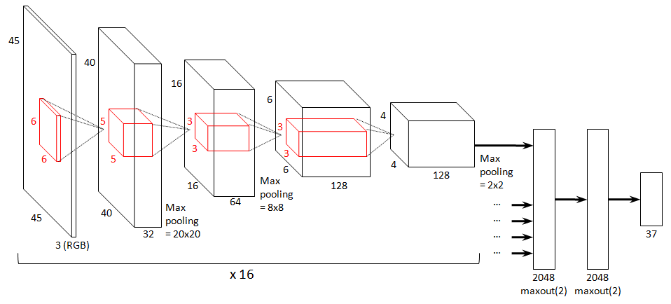
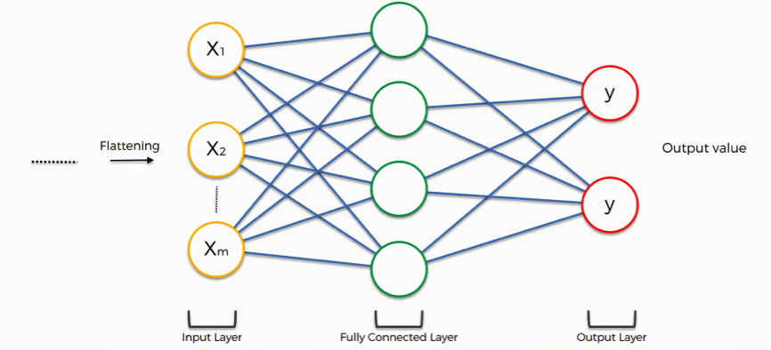
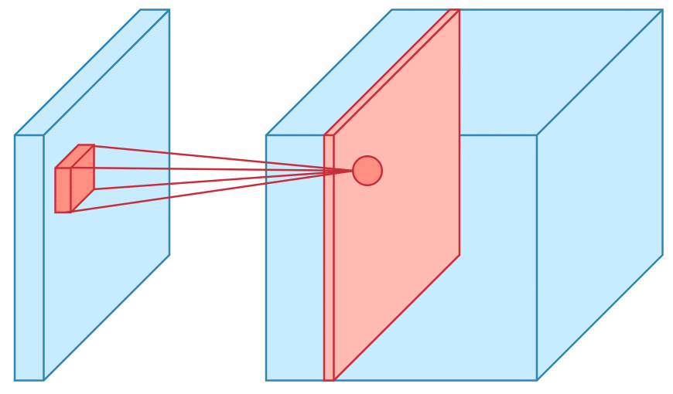
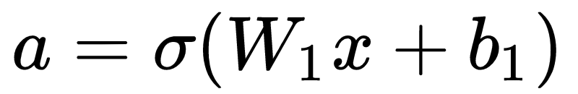
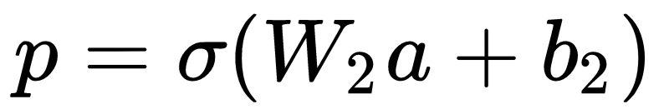
RECAPa
Fully connected network
ConvNet
conv layers
weights
neuron
FC layers
kernel
feature maps
non-linearity
Image from https://www.superdatascience.com/blogs/convolutional-neural-networks-cnn-step-4-full-connection
Image from http://benanne.github.io/images

Slide 3
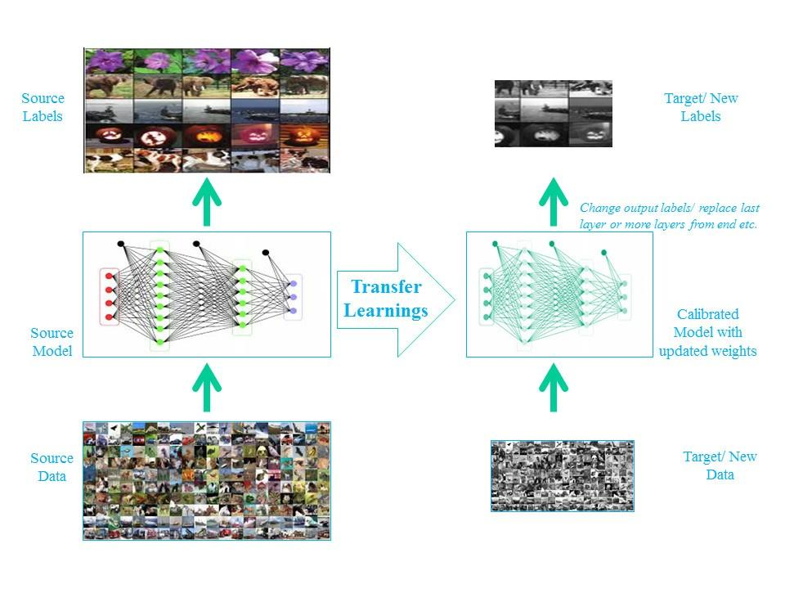
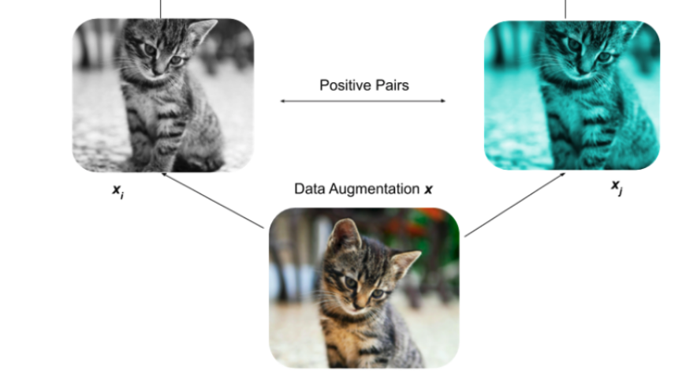
RECAPa
Transfer / Self-Supervision
Photos from: http://deeplearning.net/tutorial/fcn_2D_segm.html; https://medium.com/@wilburdes/semantic-segmentation-using-fully-convolutional-neural-networks-86e45336f99b

Slide 4
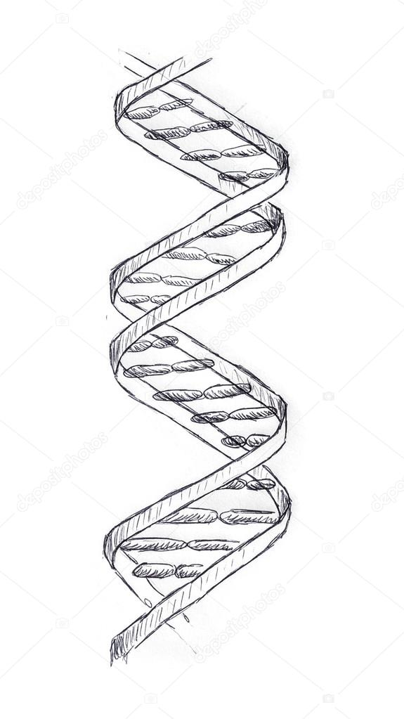


Motivation
Until now we have:
FCN: unstructured data (left)
CNN: localized data (right)
BUT sometimes we have sequential data

Slide 5

Sequences
text

Slide 6
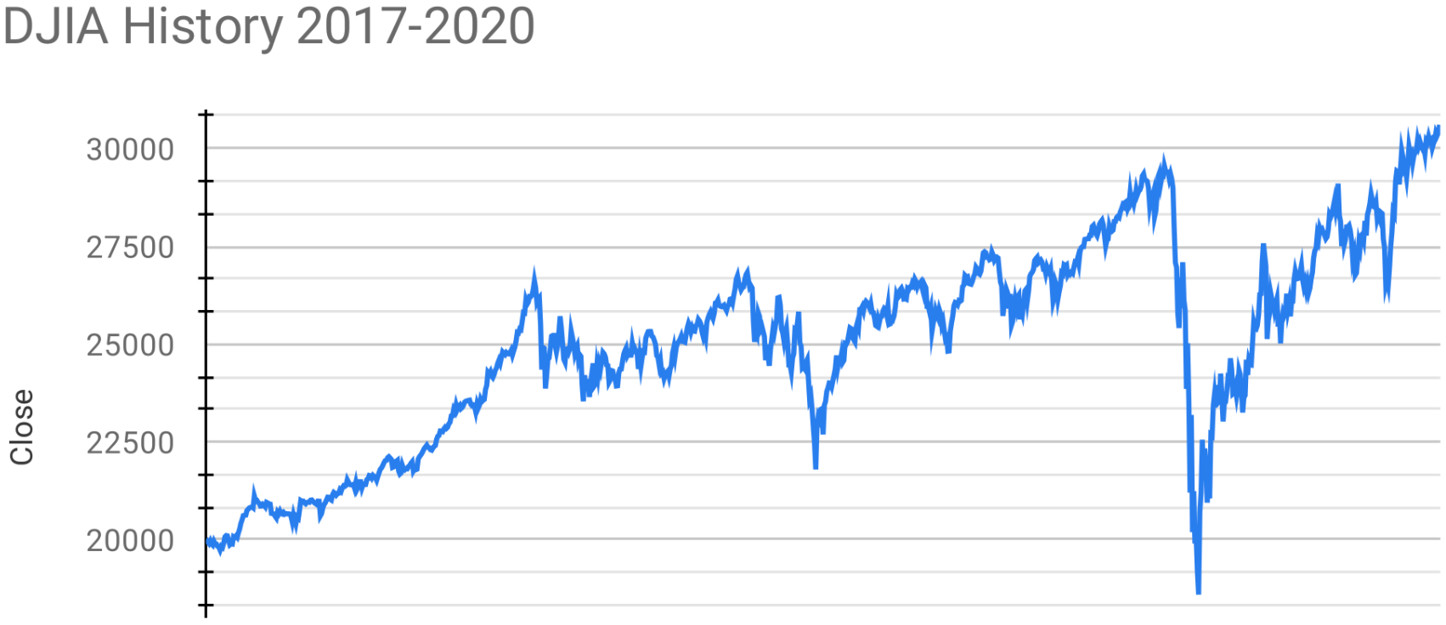
Sequences
time series

Slide 7
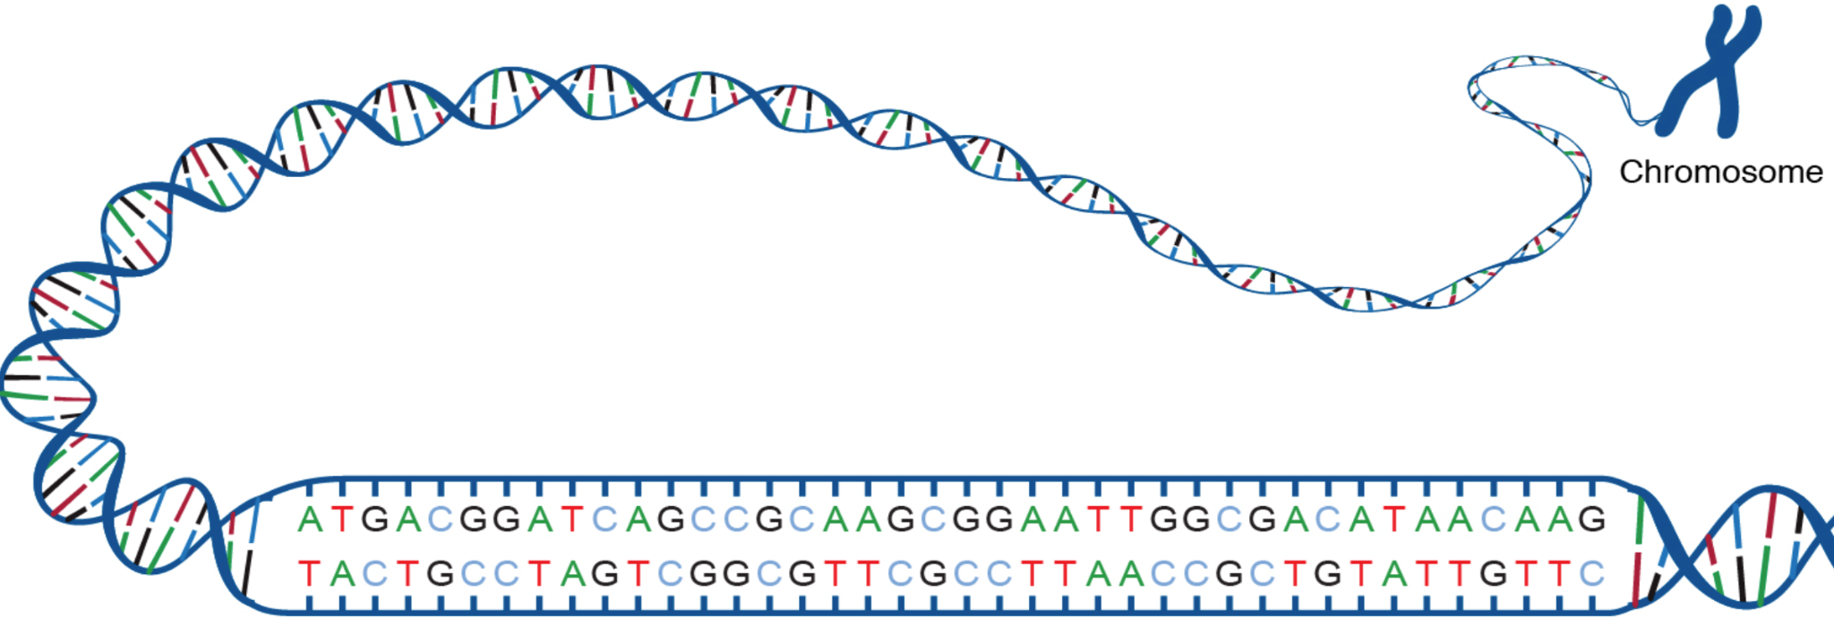
Sequences
DNA sequence

Slide 8
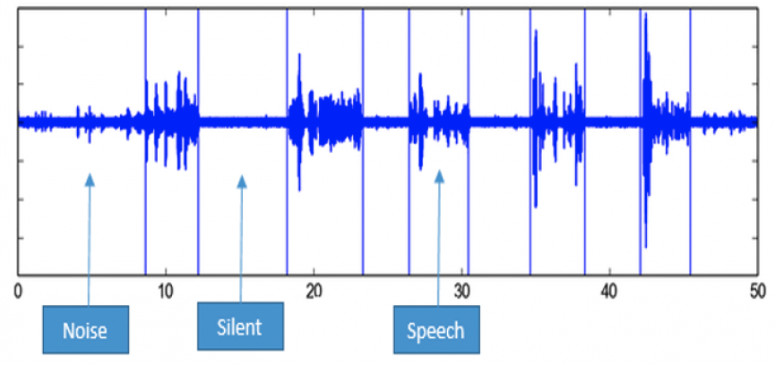
Sequences
audio

Slide 9
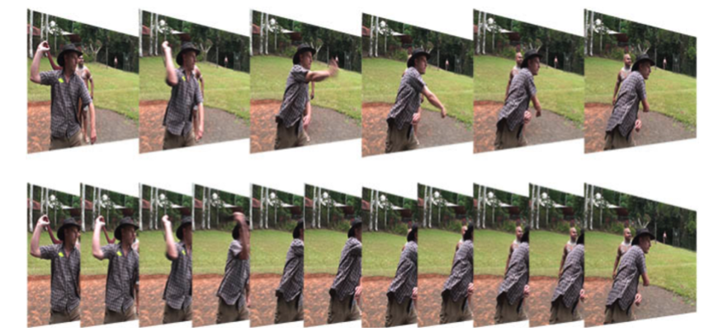
Sequences
video frames

Slide 10
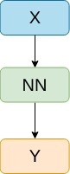
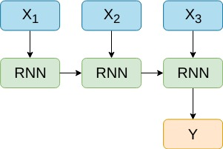

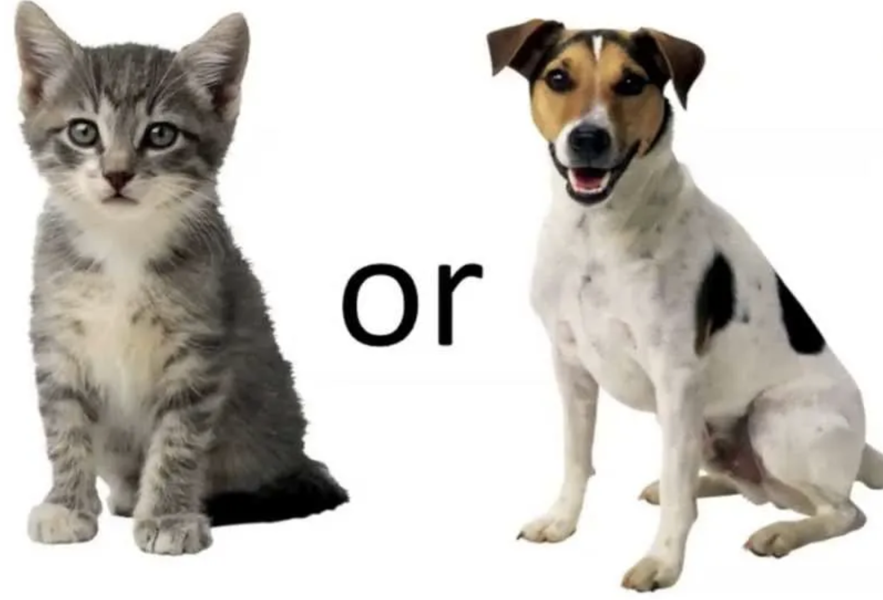

Sequence modeling applications
ONE - TO - ONE
Binary Classification
MANY - TO - ONE
Sentiment Analysis
Notes:
De dat exemple la fiecare

Slide 11
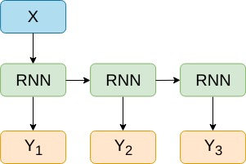
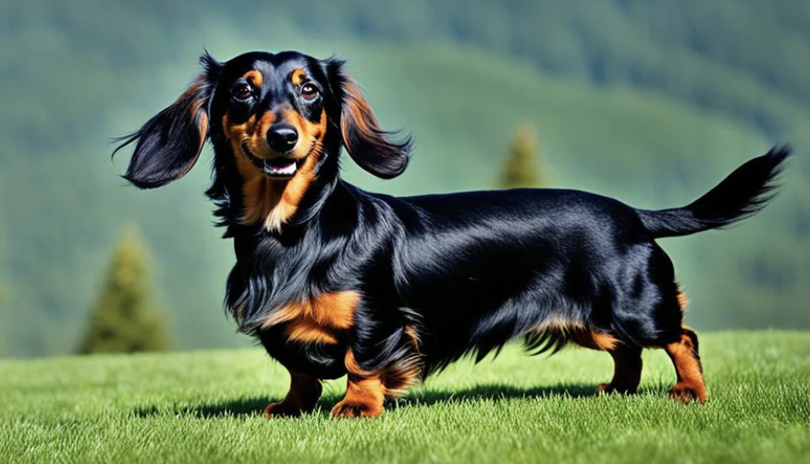
Sequence modeling applications
ONE - TO - ONE
Binary Classification
MANY - TO - ONE
Sentiment Analysis
ONE - TO - MANY
Image Captioning
long dog is happy
Notes:
De dat exemple la fiecare

Slide 12
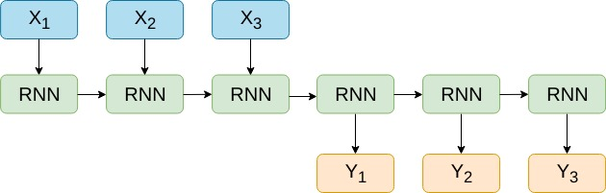
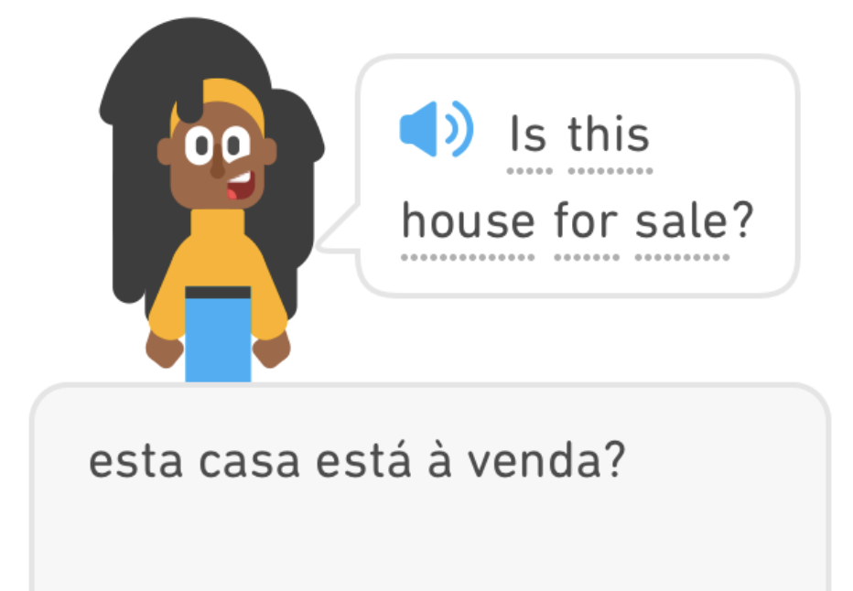
Sequence modeling applications
ONE - TO - ONE
Binary Classification
MANY - TO - MANY
Machine Translation
Notes:
De dat exemple la fiecare

Slide 13
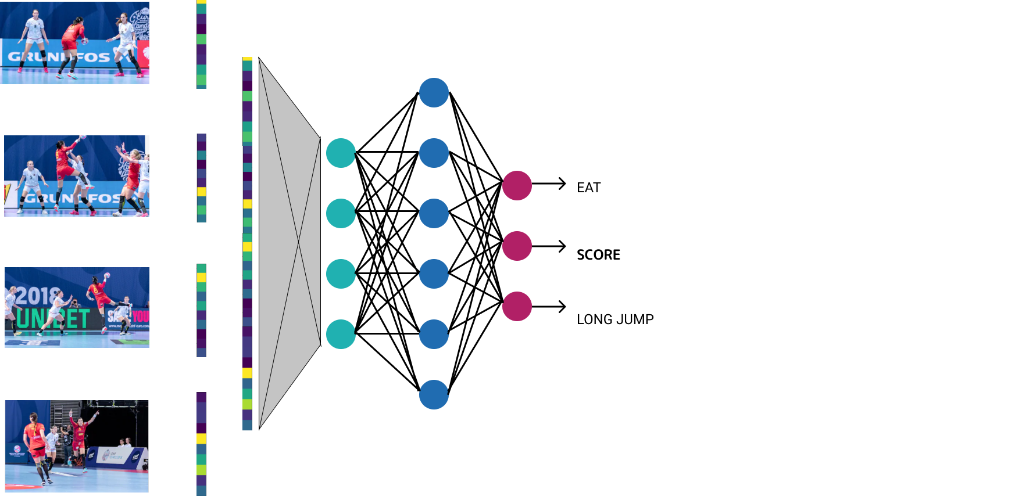
Video classification:

Slide 14
Video classification:
for each frame extract features using CNN
concatenate all the features in a huge video representation vector

Slide 15
Video classification:
for each frame extract features using CNN
concatenate all the features in a huge video representation vector
process the video representation using fully connected layers

Slide 16
Video classification:
Why not?

Slide 17
Video classification:
Why not?
∈ R^{(d1*f) x d2}
W1

Slide 18
Video classification:
?

Slide 19
Video classification:
Why not?
huge number of parameters
∈ R^{(d1*f) x d2}
W1

Slide 20
Video classification:
Why not?
huge number of parameters
different parameters for similar frames/objects
∈ R^{(d1*f) x d2}
W1

Slide 21
Video classification:
Why not?
huge number of parameters
different parameters for similar frames/objects
fixed input length
∈ R^{(d1*f) x d2}
W1

Slide 22
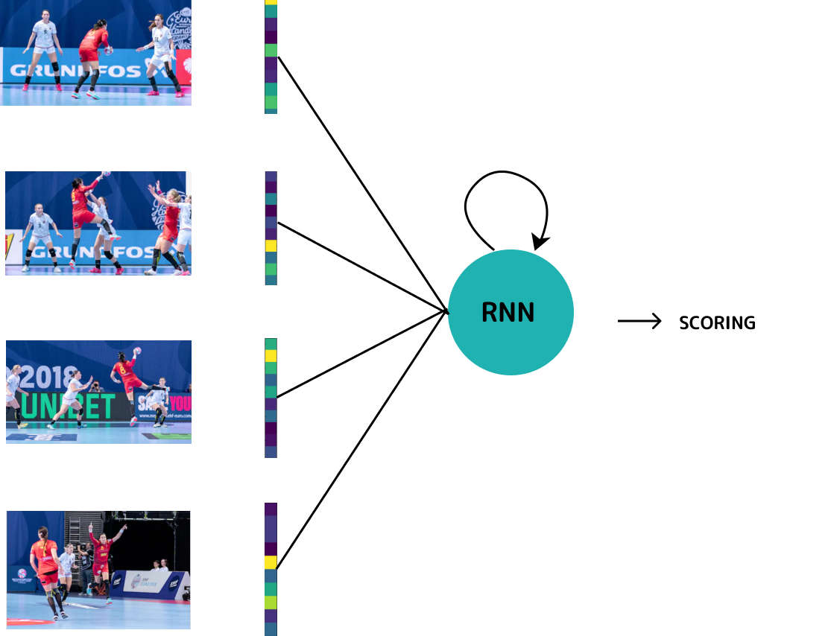
Video classification:
Solution:
Recurrent Neural Network

Slide 23
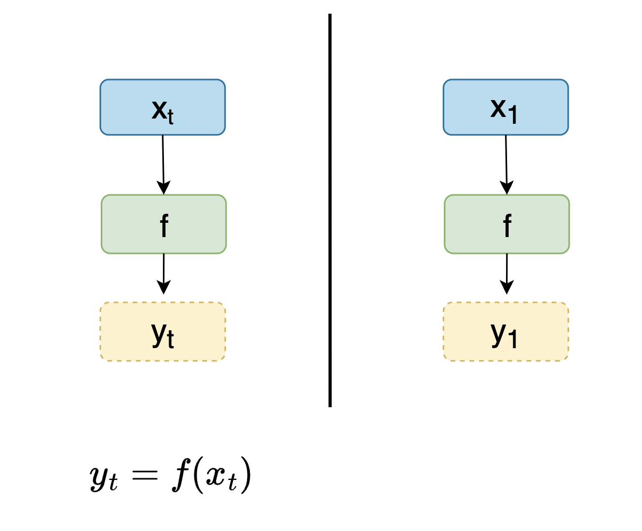
Handling individual steps

Slide 24
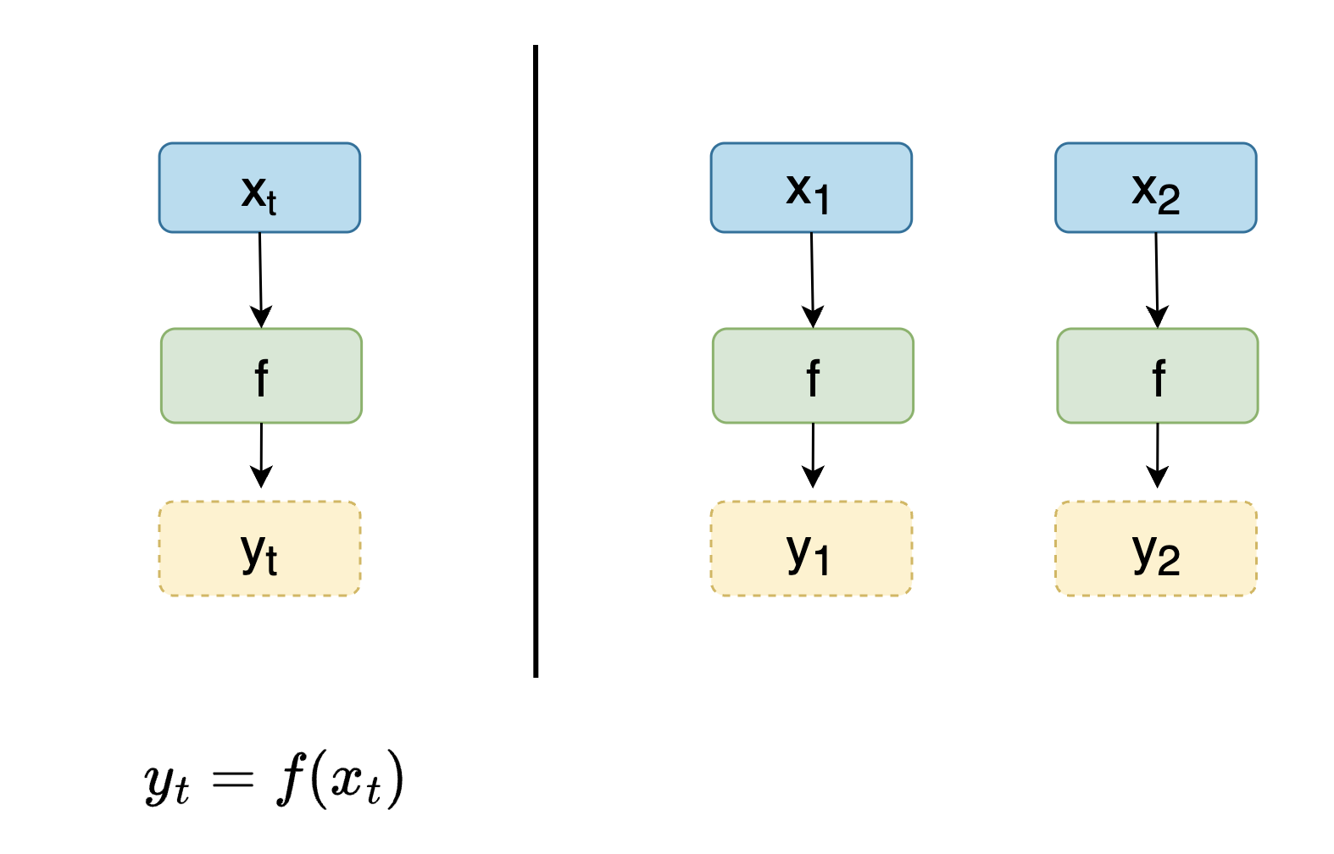
Handling individual steps

Slide 25
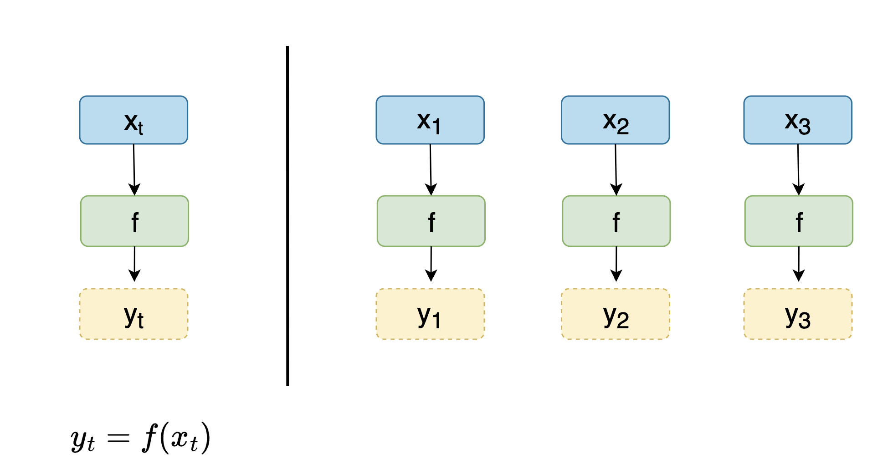
Handling individual steps

Slide 26
Handling individual steps
Q: What is the issue?

Slide 27
Handling individual steps
Q: What is the issue?
A: y₃ may depend on x₁ or x₂

Slide 28
Handling individual steps
Q: What is the issue?
A: y₃ may depend on x₁ or x₂

Slide 29
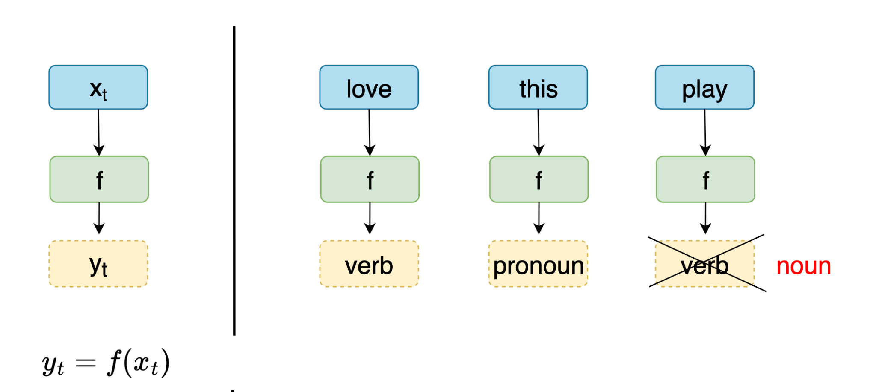
Handling individual steps
part-of-speechof the word ‘play’ depends on previous words as well

Slide 30
Handling individual steps
Q: How to link previous computations to current one?

Slide 31
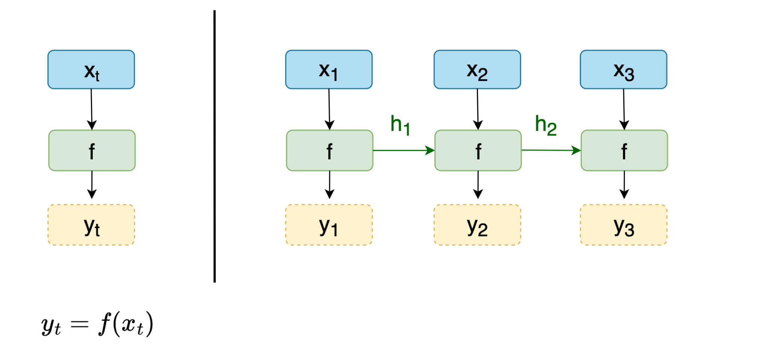
Handling individual steps
Q: How to link previous computations to current one?
A: Feed previous result to current one

Slide 32
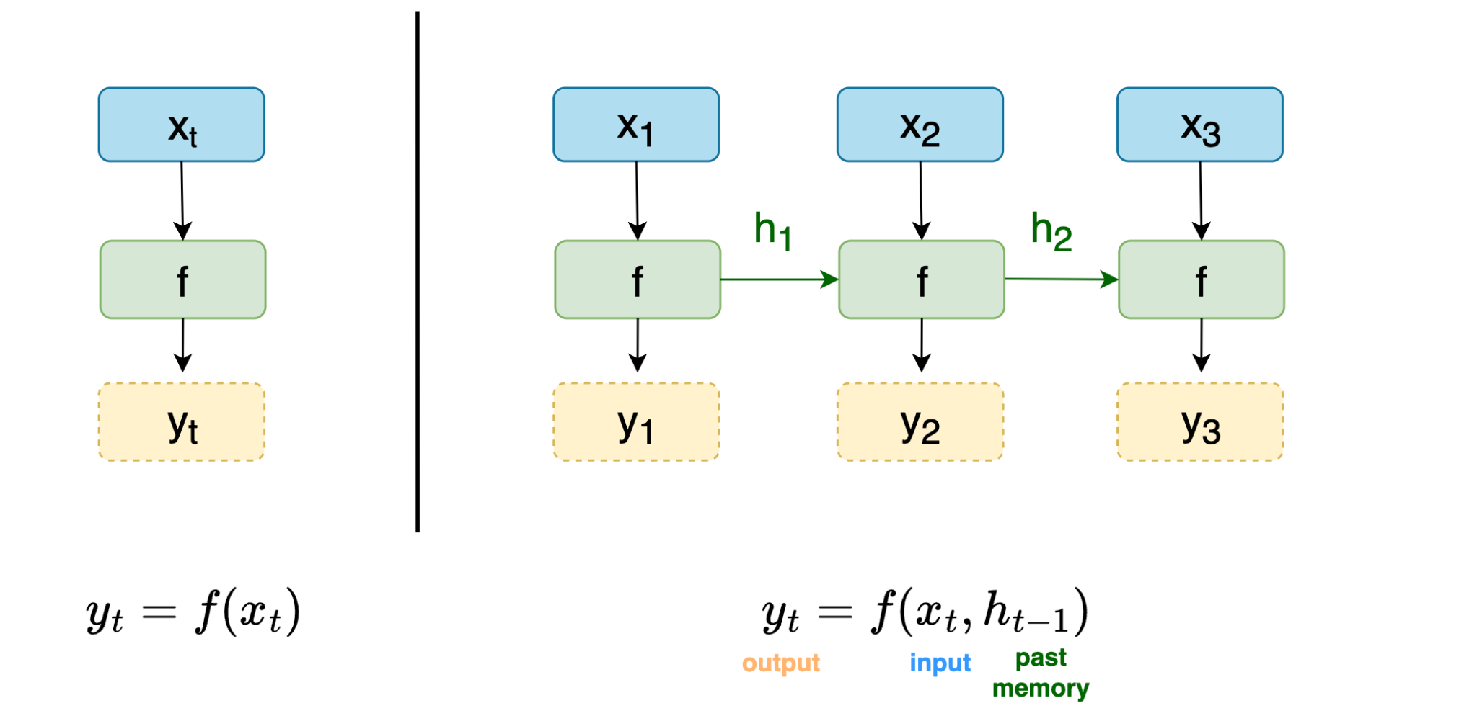
Handling individual steps

Slide 33
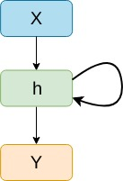
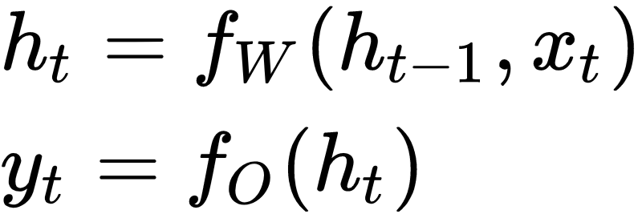
Recurrent Neural Network
key ideas:
process sequence by repeatedly applying the same recurrence formula
[optional] compute output for one or more timesteps
x_{t} - input at step t
h_{t} - hidden state at step t
y_{t} - [optional] output at step t

Slide 34
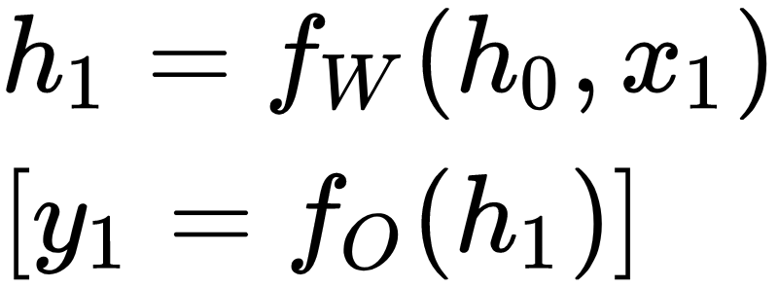
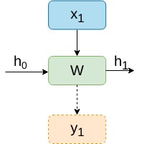
Forward step

Slide 35
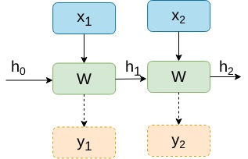
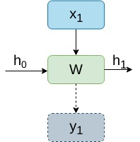
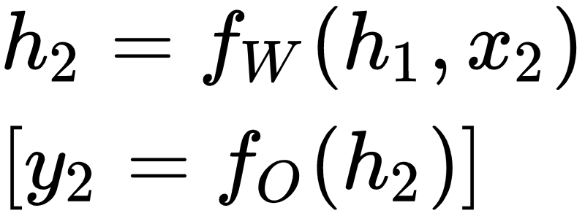
Forward step

Slide 36
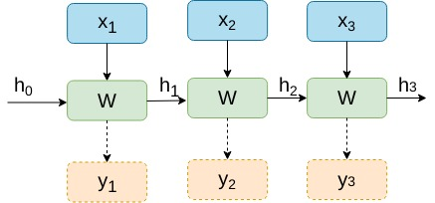
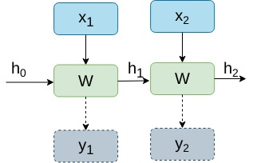
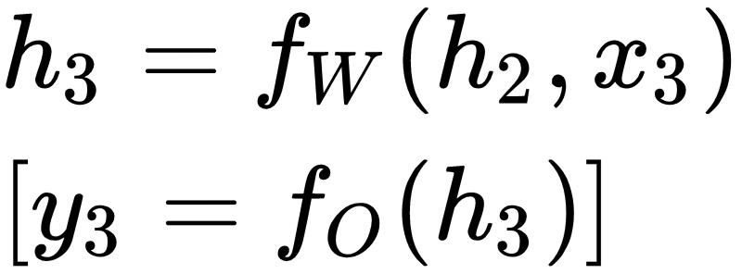
Forward step

Slide 37
Forward step
same W / same O at each time step

Slide 38
Forward step
same W / same O at each time step
allow input sequence of variable lengths
given a context and an input, all timesteps should be processed in the same way

Slide 39
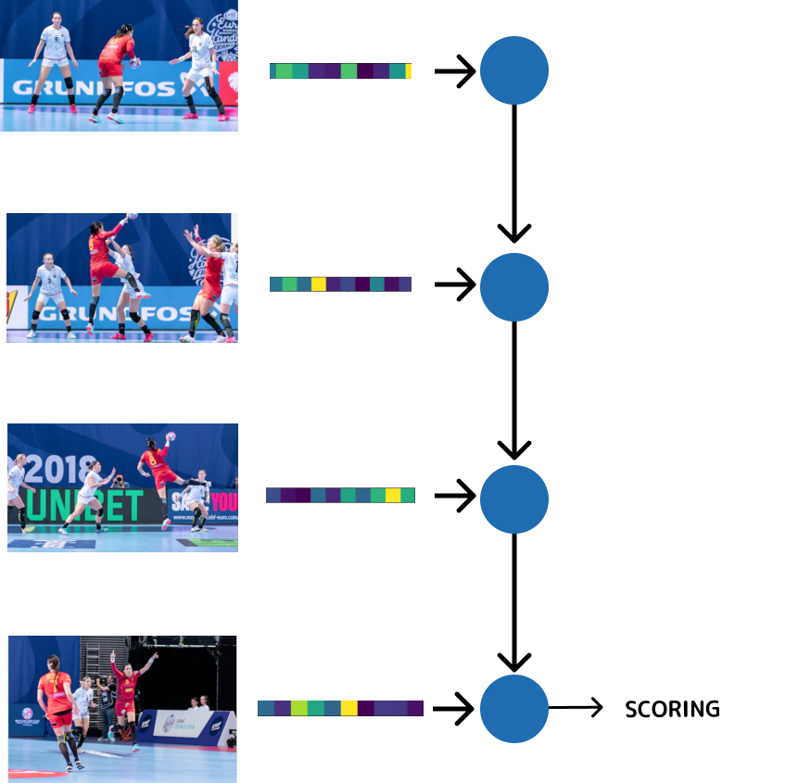
Video classification: RNN
one CNN to extract features
one RNN to process the frames features
output from the final step
(many to one)

Slide 40
Feed-forward vs RNN
MANY - TO - ONE
ONE - TO - MANY
ONE - TO - ONE
MANY - TO - MANY
Notes:
De dat exemple la fiecare

Slide 41
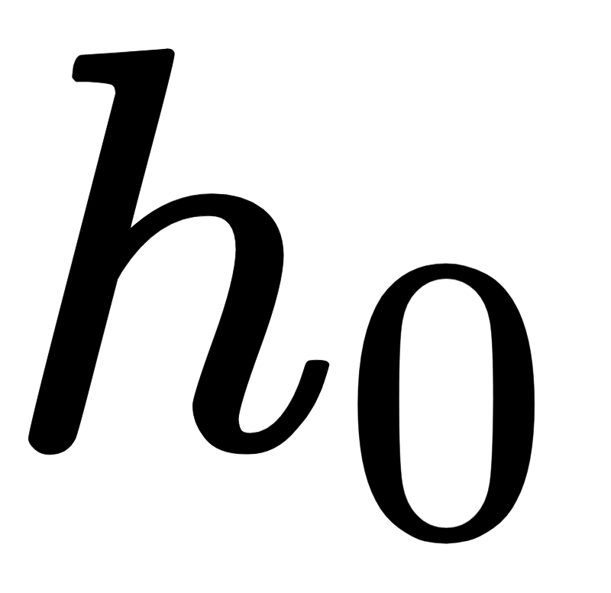
Initial state
What about ?
zeros vector
random vector
representation of data used as conditional information for current model

Slide 42
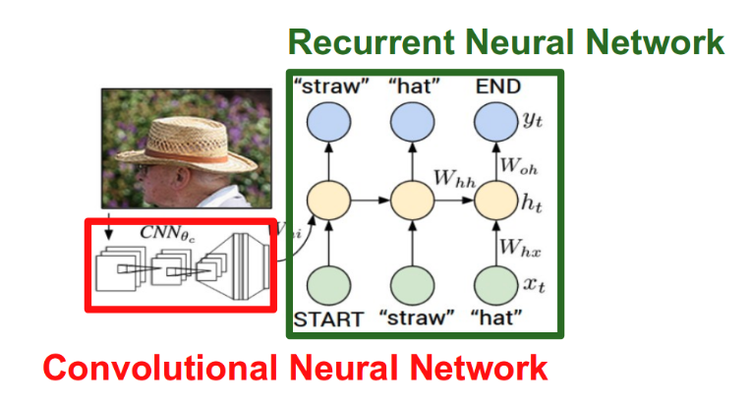
Initial state
What about ?
zeros vector
random vector
representation of data used as conditional information for current model

Slide 43
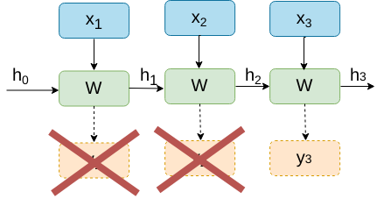
Forward: single output

Slide 44
Forward: multiple outputs (outputs != inputs)

Slide 45
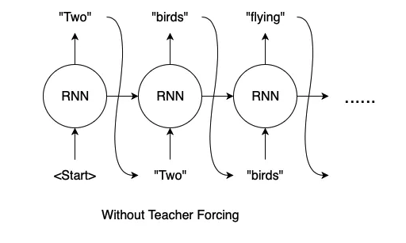
Forward: multiple outputs (outputs = inputs)
Training: Why not feed output at time t as input at t+1?

Slide 46
Forward: multiple outputs (outputs = inputs)
Training: Why not feed output at time t as input at t+1?
Early mistakes propagates in later steps:
Slow convergence
Instability of model

Slide 47
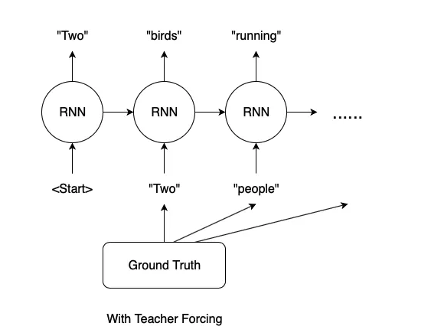
Teacher forcing
Teacher forcing:
during train phase the model receive ground truth instead of model output
later steps receive correct input even in the beginning of training
during test phase use the model’s output, because we don’t have access to the ground truth

Slide 48
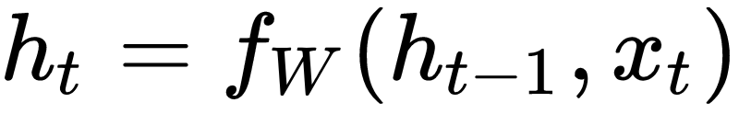
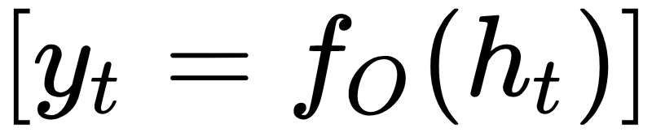
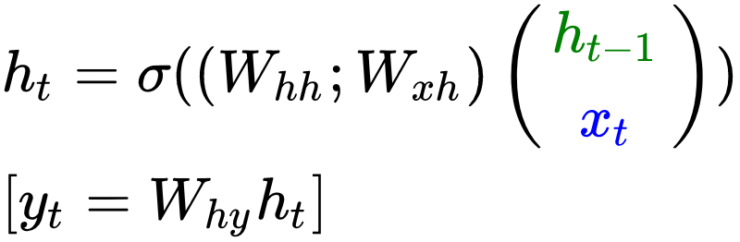
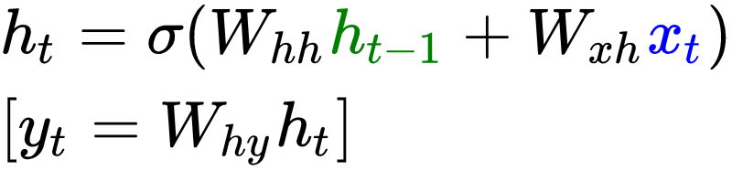

Vanilla RNN

Slide 49
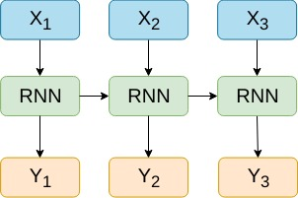
Vanilla RNN vs Multi-modal RNN
One-modal input

Slide 50
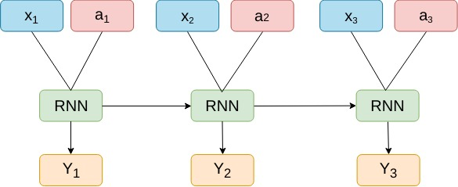
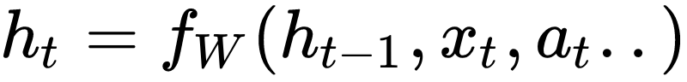


Vanilla RNN vs Multi-modal RNN
One-modal input
Multi-modal input

Slide 51




Backpropagation
RECAPa
Loss function (E) measures how close we are to the optimal solution
At train time, update parameters to minimize the loss
The update is based on gradient descent
Notes:
Cum era pana acum?

Slide 52
Backpropagation
RECAPa
Loss function (E) measures how close we are to the optimal solution
At train time, update parameters to minimize the loss
The update is based on gradient descent
We need to compute
Notes:
Cum era pana acum?

Slide 53



Backpropagation through time (BPTT)
Fancy name for regular backpropagation on an unrolled RNN
Notes:
Cum era pana acum?

Slide 54





Backpropagation through time (BPTT)
*
* Slightly change the way we define this, for an easier computation. The intuition remains the same
Notes:
Cum era pana acum?

Slide 55


Backpropagation through time (BPTT)
Notes:
Cum era pana acum?

Slide 56





Backpropagation through time (BPTT)
Notes:
Cum era pana acum?

Slide 57
Backpropagation through time (BPTT)
NO!
Notes:
Cum era pana acum?

Slide 58



Backpropagation through time (BPTT)
YES!
Notes:
Cum era pana acum?

Slide 59

Multivariable Chain Rule
W
x(w)
y(w)
f(x(w), y(w))

Slide 60







Multivariable Chain Rule
W
…

Slide 61




Backpropagation through time (BPTT)

Slide 62


Backpropagation through time (BPTT)

Slide 63



Backpropagation through time

Slide 64

Backpropagation through time
For large number of timesteps (t):
image from: https://hackernoon.com/understanding-architecture-
of-lstm-cell-from-scratch-with-code-8da40f0b71f4

Slide 65


Backpropagation through time
For large number of timesteps (t):
image from Toronto University CSC321 course 2017, R. Grosse

Slide 66


Backpropagation through time
For large number of timesteps (t):
HARD TO TRAIN
WHY?
Notes:
Ce se intampla in fiecare caz?
=> avem nevoie de solutii daca vrem sa le antrenam

Slide 67


Vanishing gradients
unable to capture long-distance dependencies
induce a bias towards recent events
Gradient can be seen as a measure for the impact of the past state for a future state
Notes:
Ce se intampla in fiecare caz?
=> avem nevoie de solutii daca vrem sa le antrenam

Slide 68
Exploding gradients
Bad updates
Huge step reaching a bad configuration
Could result in NaN parameters
Notes:
Ce se intampla in fiecare caz?
=> avem nevoie de solutii daca vrem sa le antrenam

Slide 69


Vanishing / exploding gradients
Solution 1: Gradient clipping
avoid exploding gradients
preserve direction, but a smaller step
Goodfellow et al. Deep Learning.

Slide 70

Vanishing / exploding gradients
Solution 2: Architectures:
LSTM
GRU
avoid vanishing gradients
Sepp Hochreiter and Jürgen Schmidhuber. 1997. Long Short-Term Memory. Neural Comput. 9, 8 (November 1997)
Cho, Kyunghyun et al. “Learning Phrase Representations using RNN Encoder-Decoder for Statistical Machine Translation.” EMNLP (2014).

Slide 71
Gates
gate: vector g ∈ [0,1]^{N} that filters information for input x
gated output: y = g ⊙ x
examples of fixed gates:
identity: g = [1, 1, 1, …, 1]
reset even positions: g = [1, 0, 1, 0 …, 1, 0]
halve values: g = [0.5, 0.5, …, 0.5]

Slide 72
Gates
gate: vector g ∈ [0,1]^{N} that filters information for input x
gated output: y = g ⊙ x
examples of fixed gates:
identity: g = [1, 1, 1, …, 1]
reset even positions: g = [1, 0, 1, 0 …, 1, 0]
halve values: g = [0.5, 0.5, …, 0.5]
we want to learn gates to induce certain flow in RNNs
g = σ(f_{w}(x))

Slide 73


Gating mechanism
Vanilla RNN
Simple Gate
Gates control the flow of information into the cell, allowing the model to forget/remember information adaptively:
retain previous state and discard current step => g_{t}=[1,1,...,1]
discard previous state and retain current step => g_{t}=[0,0,...,0]

Slide 74


GRU (Gated Recurrent Unit, Chung et al. 2014)
GRU use a gating mechanism with 2 gates:
update gate: determine how much of the past information needs to be passed along to the future
reset gate: determine what parts of previous hidden state are used to compute new content

Slide 75


GRU
GRU use a gating mechanism with 2 gates:
update gate: determine how much of the past information needs to be passed along to the future
reset gate: decide how to combine new input with previous state
keep/reset previous info for current target state
selects useful parts of prev hidden state to compute crt
integrate crt info into the previous one
copy/ignore previous info

Slide 76

Why do gates prevent vanishing?
update gates z_{t} close to 1 allow gradients dh_{t}/dh_{t-1} to be larger => better gradient propagation with distance

Slide 77
Where else?

Slide 78

Where else?
can be a problem for any neural network
use skip-connection to preserve identity
Several architectures: ResidualNet; DenseNet; HighwayNet

Slide 79
Where else?
can be a problem for any neural network
use skip-connection to preserve identity
Several architecture: ResidualNet; DenseNet; HighwayNet

Slide 80

Adding depth => Multilayer RNN
better capture the structure of the input sequence
might be harder to optimize (longer paths)

Slide 81


Bidirectional RNN
key idea: train 2 RNNs in both directions
at each timestep t, combine hidden states from both forward RNN and backward RNN
Schuster, Mike and Kuldip K. Paliwal. “Bidirectional recurrent neural networks.” IEEE Trans. Signal Processing 45 (1997): 2673-2681.
Notes:
Subliniat ca sunt 2 rnnuri diferite, independente pana la output

Slide 82
RNNs pros
can handle input of variable length
each step can depend on context from many steps back
symmetric, intuitive processing

Slide 83


Why not RNNs?
source
RNNs are not parallelizable across sequence
linear interaction distance:
maximum path length between distant elements is O(n)
long term dependencies still tricky to learn, even with gating mechanisms (LSTM, GRU etc.)

Slide 84

Generative AI

Slide 85

Alternative approaches for Sequential Data

Slide 86

Transformer (2017)
no RNNs: introduces multi-head self-attention
SOTA on Machine Translation (EN-DE, EN-FR)
lower computational cost: ¼ FLOPs of previous models

Slide 87

Self-Attention intuition
Identify which elements to attend to (search problem)
Extract features with high attention

Slide 88
Self-Attention intuition
Identify which elements to attend to (search problem)
Extract features with high attention

Slide 89

Self-Attention
no more recurrence
each state depends on all of the others, not only the previous one

Slide 90

Self-attention blackbox
Two steps for output i:
identify the most ‘relevant’ features for input i, by ‘looking’ at all the other input words => attention scores
0.1 * The + 0.2 * Broadway + 0.2 * play + 0.4 * premiered + 0.1 * yesterday
outputs
inputs

Slide 91
Self-attention blackbox
Two steps for output i:
identify the most ‘relevant’ features for input i, by ‘looking’ at all the other input words => attention scores
extract the most relevant features by combining inputs with attentions scores
0.1 * The + 0.2 * Broadway + 0.2 * play + 0.4 * premiered + 0.1 * yesterday
outputs
inputs

Slide 92
Self-attention blackbox
Two steps for output i:
identify the most ‘relevant’ features for input i, by ‘looking’ at all the other input words => attention scores
extract the most relevant features by combining inputs with attentions scores
0.1 * The + 0.2 * Broadway + 0.2 * play + 0.4 * premiered + 0.1 * yesterday
0.1*The + 0.1*Broadway + 0.1*play + 0.3*premiered + 0.4*yesterday
outputs
inputs

Slide 93


Key, Query and Value analogy
Scenario: I want to research a topic and I need relevant content to look through:
query - research topic
key - folder name
value - folder content
figures from http://jalammar.github.io/illustrated-gpt2/

Slide 94
Key, Query and Value analogy
Scenario: I want to research a topic and I need relevant content to look through:
Step 1: match query (topic) with keys (folder names) => relevance scores
Step 2: retrieve content from each folder (value) according to relevance
figures from http://jalammar.github.io/illustrated-gpt2/

Slide 95

Self-attention steps
compute attention scores by taking dot products between query and keys
figure from http://jalammar.github.io/illustrated-transformer/

Slide 96
Self-attention steps
compute attention scores by taking dot products between query and keys
scale and normalize attention scores

Slide 97
Self-attention steps
compute attention scores by taking dot products between query and keys
scale and normalize attention scores
contextual embedding for each word is the weighted sum of values and their attention scores

Slide 98

Self-attention is parallelizable
context vectors are computed simultaneously for all input vectors
complexity: O(N²d)
figure from http://jalammar.github.io/illustrated-transformer/

Slide 99


Positional Awareness
Self-attention has no temporal order information:
the cat sat on the mat
the mat sat on the cat
figure from http://www.poetrypicture.club/the-cat-sat-on-the-mat/

Slide 100

Positional Encoding
add position-aware encodings to the word embeddings so that order matters
these encodings are either:
fixed and precomputed (no learned parameters)
learned embeddings
figure from http://jalammar.github.io/illustrated-transformer/
Notes:
For an in-depth explanation of the original fixed positional encoding (used in ‘Attention is all you need’), see this resource: https://kazemnejad.com/blog/transformer_architecture_positional_encoding/

Slide 101

Masked self-attention
inputs should not ‘peak’ into the future
each input can only ‘attend’ to previous inputs
figure from figure from http://jalammar.github.io/illustrated-gpt2/

Slide 102
Transformer block
multi-head self-attention is part of Transformer block
other key ingredients:
residual connections
layer normalization
FC layer after self-attention

Slide 103

LayerNorm
normalizes across features, not examples

Slide 104


Multi-head self-attention
multiple self-attention heads can learn different relationships

Slide 105
Transformer block - recap
recurrent-free, parallelizable alternative for sequence processing
lower computational complexity than RNNs: O(N²d) vs O(Nd²)
constant gradient path (every element directly interacts with all the other elements)
building block for SOTA architectures in NLP (BERT) and most foundational models (GPT3-4, CLIP, ViT)

Slide 106

RNN vs self-attention
in RNNs, sequence elements are processed step by step
in self-attention, sequence elements are processed all at once
source self-attention https://towardsdatascience.com/illustrated-self-attention-2d627e33b20a

Slide 107

RNN vs CNN vs self-attention
RNN (O(Nd²)):
cannot be parallelized across sequence
CNN (O(kNd²)):
parallelizable across sequence
self-attention (O(N²d)):
parallelizable across sequence
source

Slide 108
RNN vs CNN vs self-attention
RNN (O(Nd²)):
cannot be parallelized across sequence
maximum path length O(N)
bias towards recent past (due to sequential nature)
CNN (O(kNd²)):
parallelizable across sequence
maximum path length O(N/k)
self-attention (O(N²d)):
parallelizable across sequence
maximum path length O(1) => equal preference for distant or recent past
source

Slide 109
RNN vs CNN vs self-attention
RNN (O(Nd²)):
cannot be parallelized across sequence
maximum path length O(N)
bias towards recent past (due to sequential nature)
fast generation: no need to recompute sequence for each new token (history already stored in previous state)
CNN (O(kNd²)):
parallelizable across sequence
maximum path length O(N/k)
slow generation: recompute sequence for each new token
self-attention (O(N²d)):
parallelizable across sequence
maximum path length O(1) => equal preference for distant or recent past
slow generation: recompute sequence for each new token
source

Slide 110
Transformers drawbacks
computational complexity = O(N²d), where N=seq. length, d=hidden dim
training: slower and more memory hungry with larger N
generation:
each new token must attend to increasingly more tokens
remember, for RNNs we just reuse previous hidden state

Slide 111

Transformers vs RNNs

Slide 112

source: https://analyticsindiamag.com/mamba-is-here-to-mark-the-end-of-transformers/
Notes:
https://www.datacamp.com/tutorial/introduction-to-the-mamba-llm-architecture
https://newsletter.maartengrootendorst.com/p/a-visual-guide-to-mamba-and-state

Slide 113
Mamba (2024)
based on SSMs (state space models), an RNN-like architecture
linear scaling in sequence length (just like RNNs) => fast inference
parallelizable => fast training
outperform Transformers-based LLMs of similar size on NLP and audio tasks
Notes:
https://www.datacamp.com/tutorial/introduction-to-the-mamba-llm-architecture
https://newsletter.maartengrootendorst.com/p/a-visual-guide-to-mamba-and-state

Slide 114


TODAY
RNNs handle sequential data (but suffer from vanishing / exploding gradients)
clipping gradients and gated architectures (LSTM/GRU) address or gradients
Transformers is a parallelizable alternative to recurrent networks
recent works based on SSMs yield both efficient inference and training

Slide 115
Thank you!
(Next: Natural Language Processing Applications)

Slide 116
Other Resources
http://www.cs.toronto.edu/~rgrosse/courses/csc321_2018/ - Lectures 15-16
https://www.cs.ox.ac.uk/people/nando.defreitas/machinelearning/ - Lecture 12-13
http://cs231n.stanford.edu/slides/2017/cs231n_2017_lecture10.pdf - Lecture 10
http://cs224d.stanford.edu/syllabus.html Lecture 6-8
http://karpathy.github.io/2015/05/21/rnn-effectiveness/
GRU: https://arxiv.org/abs/1406.1078
LSTM: https://www.bioinf.jku.at/publications/older/2604.pdf

